Slide 1



CSE 543 Information Assurance and Security
Information Assurance in
Cloud Computing Systems
Professor Stephen S. Yau
Spring 2022

Slide 2
Evolution of Computing Paradigms
Main Frame Computer
Personal
Computer
Object Oriented Computing
Grid Computing
Service Computing
Cloud Computing
Internet of
Things
1950s
Early
1970s
Early
1980s
Mid 1990s
2001
2005
2009
Smart Devices
Wireless Technology
Virtualization Technology
Internet and LAN
(Distributed Computing)
S. S. Yau

Slide 3
Major New Computing Paradigms (cont.) - Service-oriented Computing
Service-oriented computing
Abstraction of functional units as software services with discoverable and interoperable interfaces, which can be described using common standards, such as WSDL
S. S. Yau

Slide 4
Major New Computing Paradigms (cont.) - Service-oriented Computing
Major characteristics: loosely-coupling, late-
binding, autonomy, composability
Realize workflows (business processes) by
service composition
S. S. Yau

Slide 5
Cloud Computing
Derived from service computing and resource
virtualization technologies (including Internet)
Massively scalable computing capabilities provided ‘as a service’ to multiple customers simultaneously
IT resources across the Internet are dynamically configured and virtualized
IT as an on-demand service
Private, public and hybrid cloud systems
S. S. Yau

Slide 6
Major Characteristics of Cloud Computing
Resource pooling
Heterogeneity
Broad network access
Agility
Usability
On-demand service
Usage accounting
Automation
S. S. Yau

Slide 7
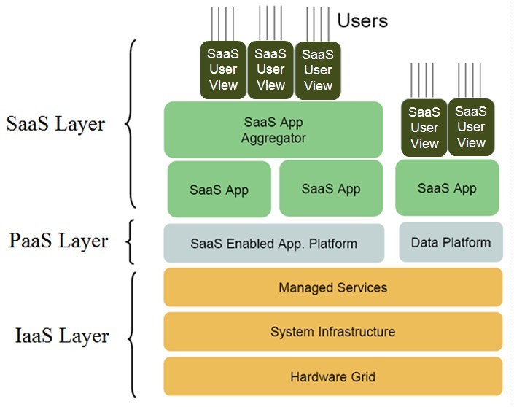
Cloud Computing Paradigms (cont.)
S. S. Yau

Slide 8
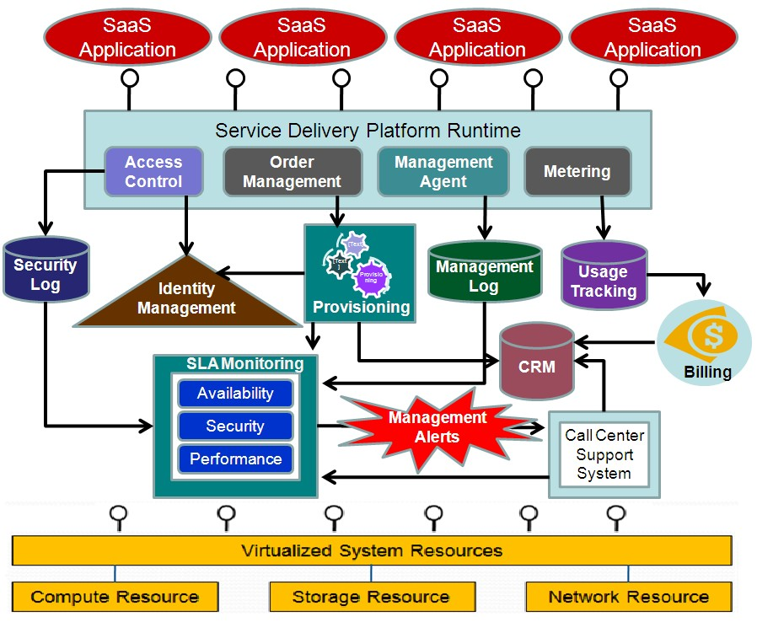
Cloud Computing System Architecture
SaaS
PaaS
IaaS
S. S. Yau

Slide 9
Mobile Cloud Computing
Emerging and considered as a cloud computing infrastructure, where data and processing occur outside mobile devices
enabling new types of applications involving use of mobile devices, including handset centric features and network related features, such as GPS and/or cell-based location information.
S. S. Yau

Slide 10
Data Centers
Edge Computing
Smart Devices
(Fog Computing)
S. S. Yau

Slide 11
Concerns of Cloud and Mobile Cloud Users
Most cloud users are concerned with leakage of their sensitive data in the cloud because their data is processed and stored on machines owned and operated by various service providers, not controlled by users.
Due to the severe limitation of resources available in mobile devices and characteristics of mobile cloud computing, security for mobile cloud computing are more severe.
S. S. Yau

Slide 12
Challenges: IA in Cloud Computing
How to protect confidentiality and privacy of users’ sensitive data from service providers?
How to protect integrity of users' data within cloud?
How to ensure that service providers will comply with security policies?
S. S. Yau

Slide 13
Challenges: IA in Cloud Computing
How to ensure the availability and reliability of each third-party service?
How to support QoS adaptation in dynamic situation of the cloud?
How to improve authentication and authorization of mobile devices in mobile cloud?
How to improve network security, including mobile networks?
S. S. Yau

Slide 14
Challenges: IA in Cloud Computing (cont.)
How to avoid threat of malwares in cloud computing, especially in mobile cloud?
Protection of confidentiality and privacy of users’ sensitive data from service providers
Protection of integrity of cloud
S. S. Yau

Slide 15
Current State of Art:
IA in Cloud Computing (cont.)
Assurance that service providers will comply with security policies
Assurance of availability and reliability of third-party services
Support for QoS adaptation in cloud
S. S. Yau

Slide 16
Current State of Art:
IA in Cloud Computing (cont.)
Improve authentication and authorization
for mobile cloud
Improve mobile network security.
Reduce threat of malware in mobile cloud
…
S. S. Yau

